Slide 1
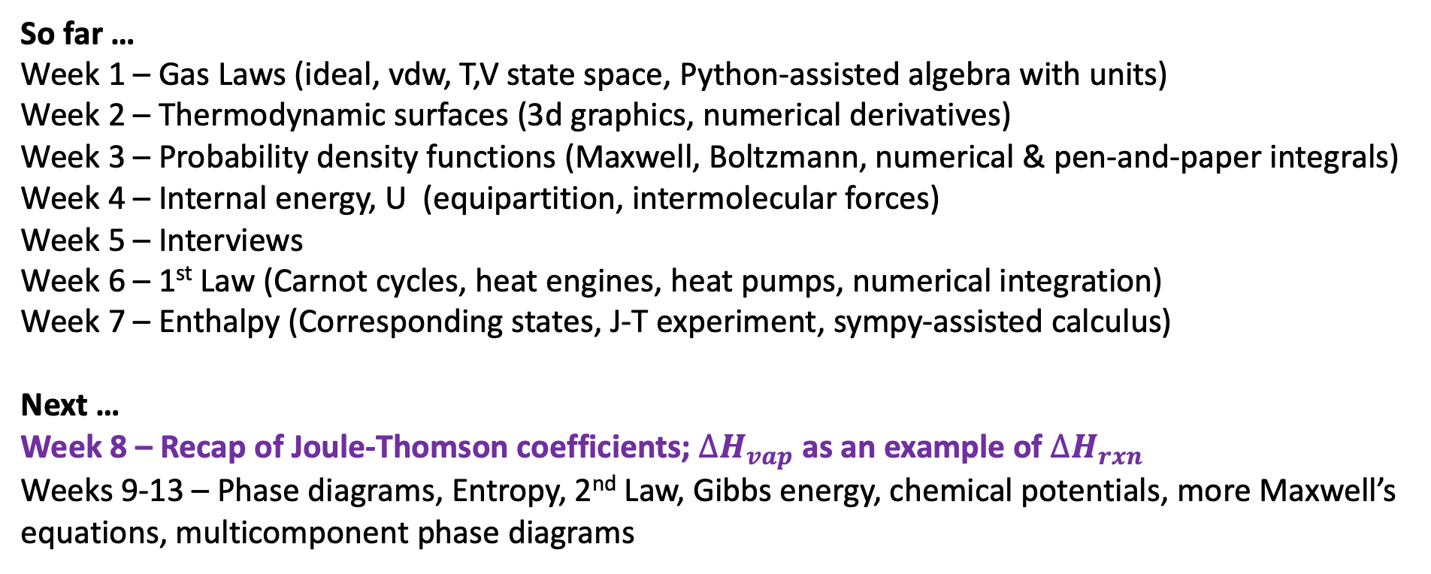
Retrospective and prospective
So far …
Week 1 – Gas Laws (ideal, vdw, T,V state space, Python-assisted algebra with units)
Week 2 – Thermodynamic surfaces (3d graphics, numerical derivatives)
Week 3 – Probability density functions (Maxwell, Boltzmann, numerical & pen-and-paper integrals)
Week 4 – Internal energy, U (equipartition, intermolecular forces)
Week 5 – Interviews
Week 6 – 1st Law (Carnot cycles, heat engines, heat pumps, numerical integration)
Week 7 – Enthalpy (Corresponding states, J-T experiment, sympy-assisted calculus)
Next …
Week 8 – Recap of Joule-Thomson coefficients; $∆H_{vap}$ as an example of $∆H_{rxn}$
Weeks 9-13 – Phase diagrams, Entropy, 2nd Law, Gibbs energy, chemical potentials, more Maxwell’s equations, multicomponent phase diagrams

Slide 2
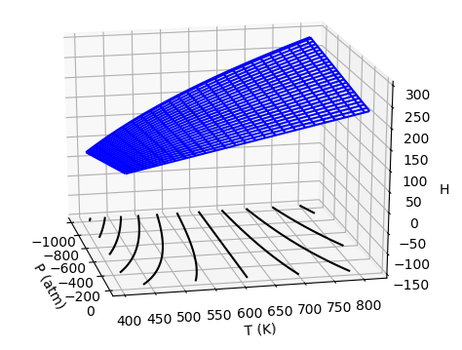
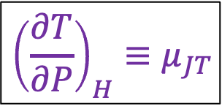
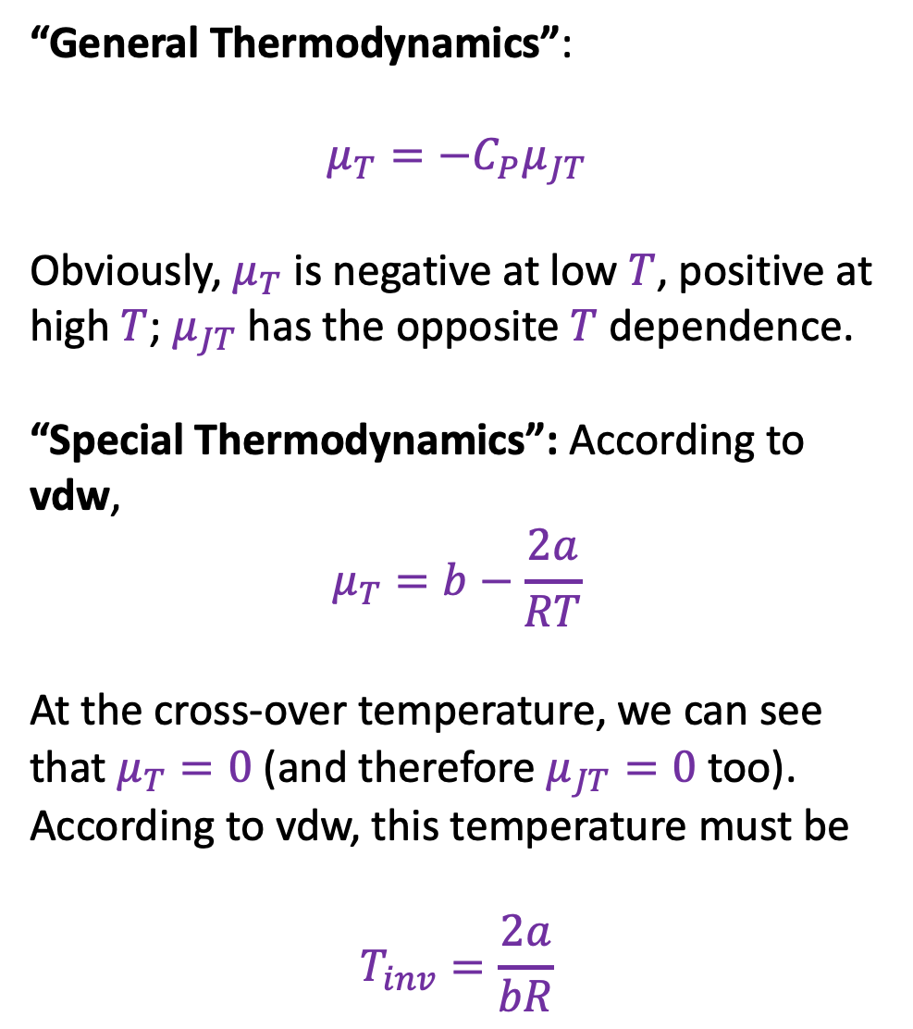
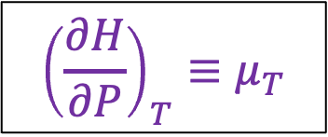
Recap of Joule-Thomson coefficients
“General Thermodynamics”:
$$μ_{T}=−C_{P}μ_{JT}$$
Obviously, $μ_{T}$ is negative at low $T$, positive at high $T$; $μ_{JT}$ has the opposite $T$ dependence.
“Special Thermodynamics”: According to vdw,
$$μ_{T}=b−\frac{2a}{RT}$$
At the cross-over temperature, we can see that $μ_{T}=0$ (and therefore $μ_{JT}=0$ too). According to vdw, this temperature must be
$$T_{inv}=\frac{2a}{bR}$$
$${{\left(\frac{∂H}{∂P}\right)}_{T}≡μ}_{T}$$
$${{\left(\frac{∂T}{∂P}\right)}_{H}≡μ}_{JT}$$

Slide 3
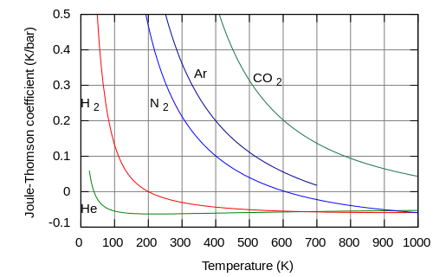
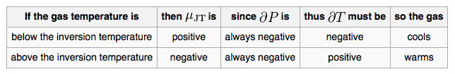
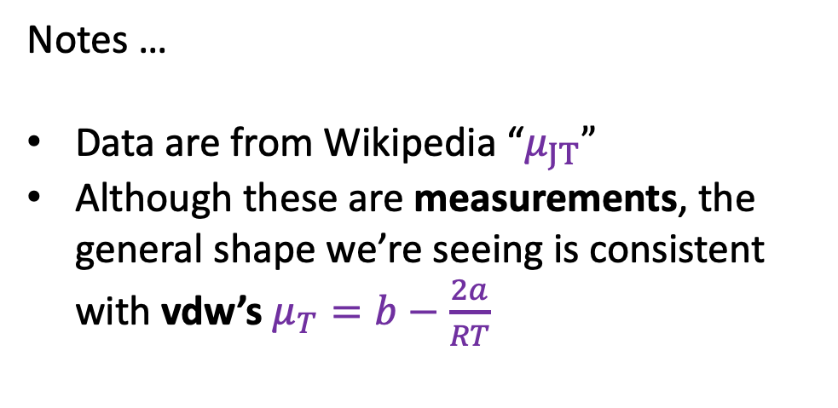
Bird’s-eye view of Joule-Thomson coefficients
Notes …
Data are from Wikipedia “$μ_{JT}”$
Although these are measurements, the general shape we’re seeing is consistent with vdw’s $μ_{T}=b−\frac{2a}{RT}$

Slide 4
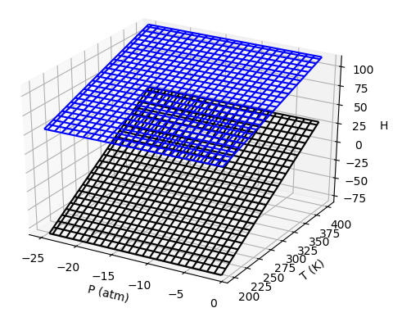
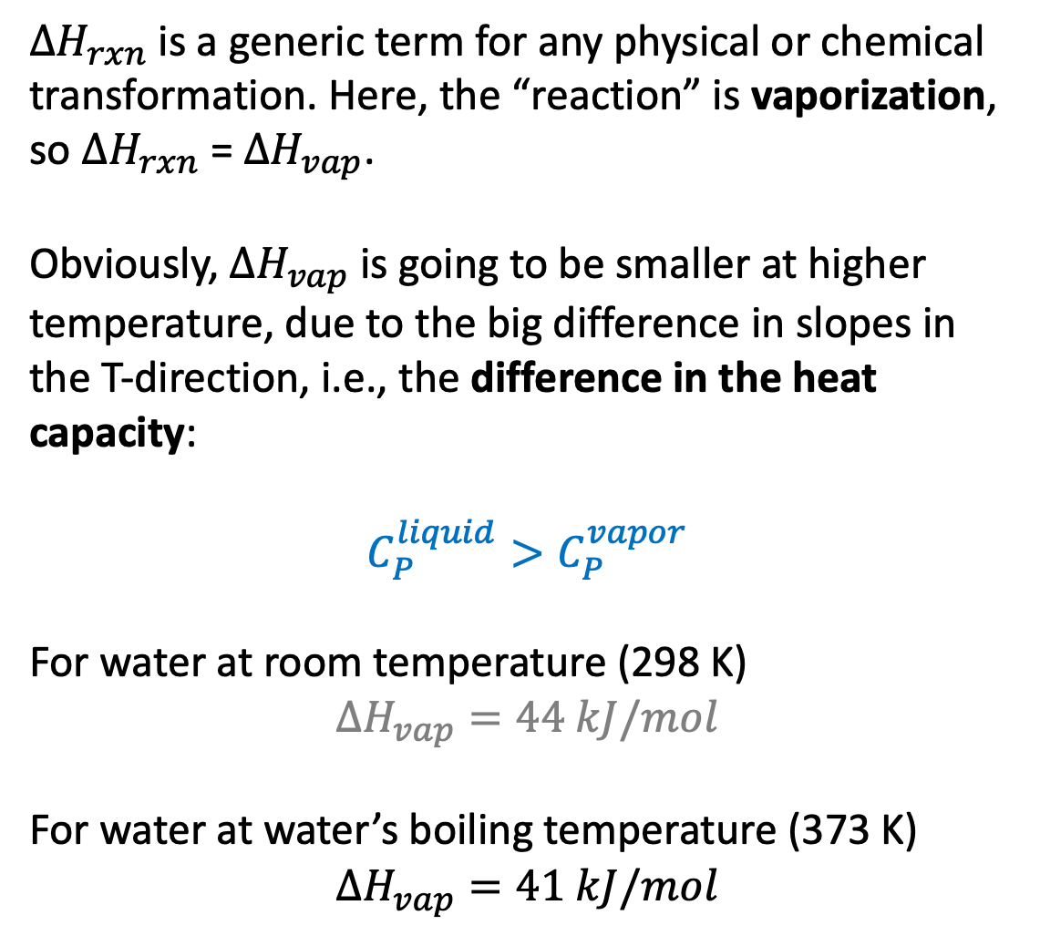

$∆H_{rxn}$ from the perspective of thermodynamic surfaces
$∆H_{rxn}$is a generic term for any physical or chemical transformation. Here, the “reaction” is vaporization, so $∆H_{rxn}$ = $∆H_{vap}$.
Obviously, $∆H_{vap}$ is going to be smaller at higher temperature, due to the big difference in slopes in the T-direction, i.e., the difference in the heat capacity:
$$C_{P}^{liquid}>C_{P}^{vapor}$$
For water at room temperature (298 K)
$$∆H_{vap}=44 kJ/mol$$
For water at water’s boiling temperature (373 K)
$$∆H_{vap}=41 kJ/mol$$
$$∆H_{vap}$$
Upper surface (product) is vapor
Lower surface (reactant) is liquid

Slide 5
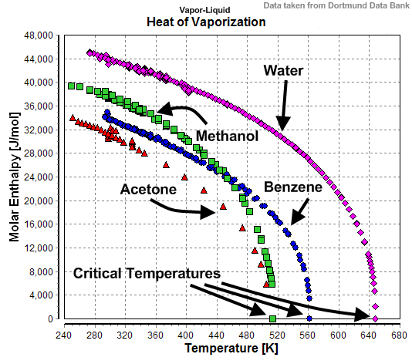
Observations of $∆H_{vap}$
$$∆H_{vap}$$
Other substances behave similarly – and all because the heat capacities of liquids are bigger than the heat capacities of the corresponding gaseous forms.

Slide 6
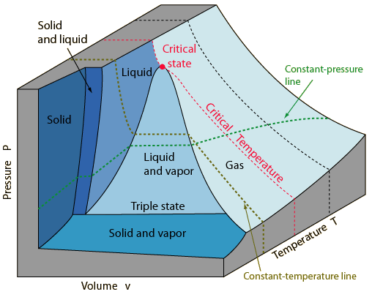
Observations of $∆H_{vap}$
$$∆H_{vap}$$
Other substances behave similarly – and all because the heat capacities of liquids are bigger than the heat capacities of the corresponding gaseous forms. This is another manifestation of the correspondence principle

Slide 7
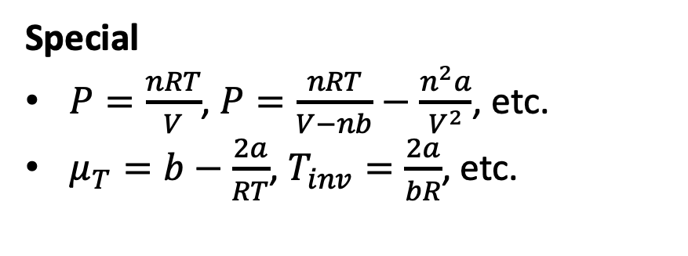
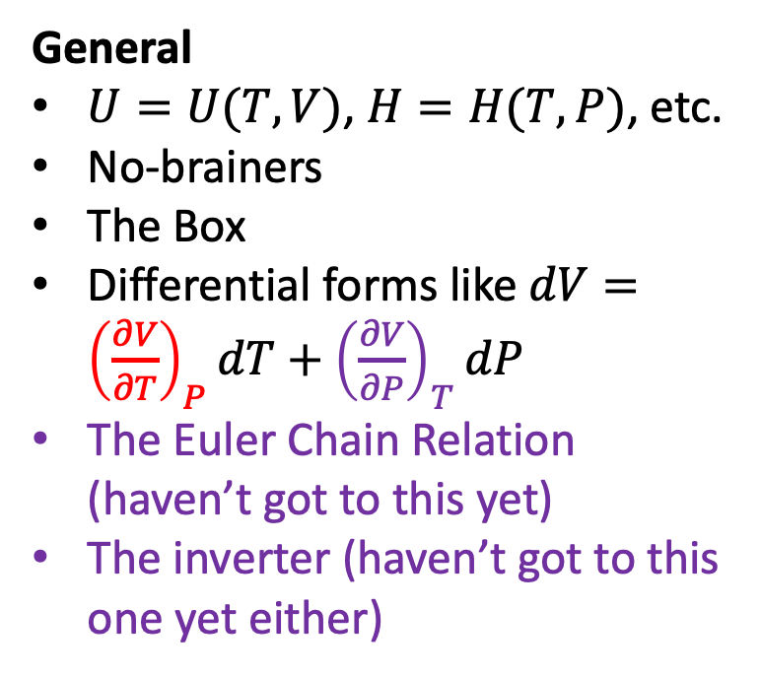
Back to the idea of “General Thermodynamics” vs “Special Thermodynamics”
To wrap up our work on Joule-Thomson, it’s useful to think about all the equations we’ve worked with so far as being General or Special. Can you do that sorting?
General
$U=U(T,V)$, $H=H(T,P)$, etc.
No-brainers
The Box
Differential forms like $dV={\left(\frac{∂V}{∂T}\right)}_{P}dT+{\left(\frac{∂V}{∂P}\right)}_{T}dP$
The Euler Chain Relation (haven’t got to this yet)
The inverter (haven’t got to this one yet either)
Special
$P=\frac{nRT}{V}$, $P=\frac{nRT}{V−nb}−\frac{n^{2}a}{V^{2}}$, etc.
$μ_{T}=b−\frac{2a}{RT}$, $T_{inv}=\frac{2a}{bR}$, etc.

Slide 8
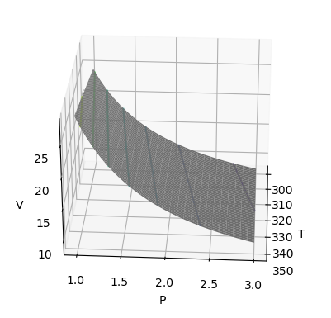
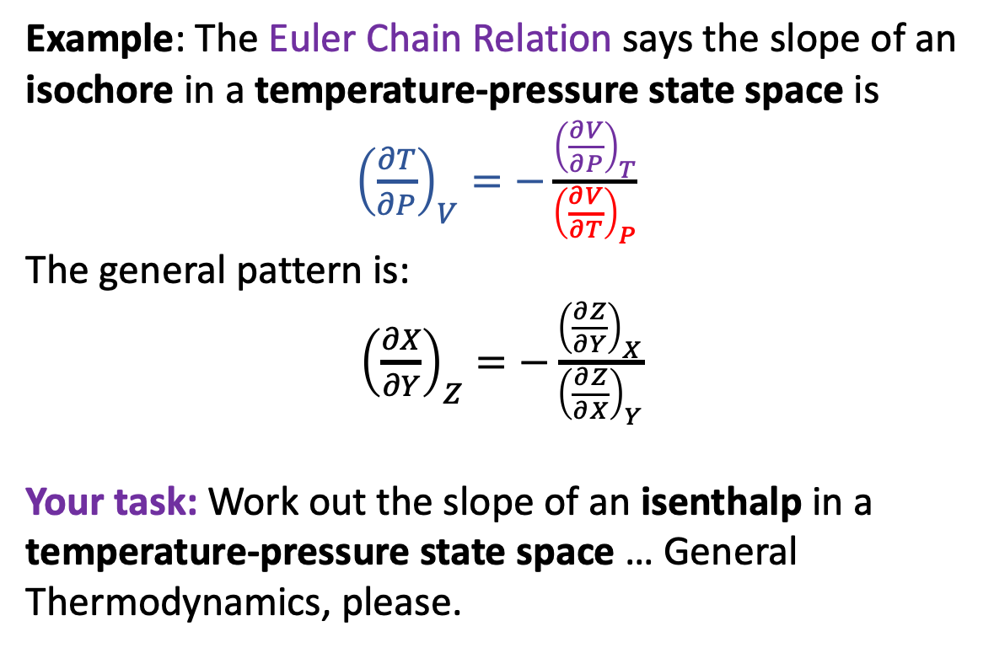




Another route connecting $μ_{T}$ to $C_{P}$
To complete the derivation of $μ_{T}$, we’ll need one more tool in our tool box in addition to the ones we’ve had so far: The Euler Chain Relation
Example: The Euler Chain Relation says the slope of an isochore in a temperature-pressure state space is
${\left(\frac{∂T}{∂P}\right)}_{V}=−\frac{{\left(\frac{∂V}{∂P}\right)}_{T}}{{\left(\frac{∂V}{∂T}\right)}_{P}}$
The general pattern is:
${\left(\frac{∂X}{∂Y}\right)}_{Z}=−\frac{{\left(\frac{∂Z}{∂Y}\right)}_{X}}{{\left(\frac{∂Z}{∂X}\right)}_{Y}}$
Your task: Work out the slope of an isenthalp in a temperature-pressure state space … General Thermodynamics, please.
$${\left(\frac{∂V}{∂T}\right)}_{P}$$
$${\left(\frac{∂V}{∂P}\right)}_{T}$$
$${\left(\frac{∂T}{∂P}\right)}_{V}$$

Slide 9
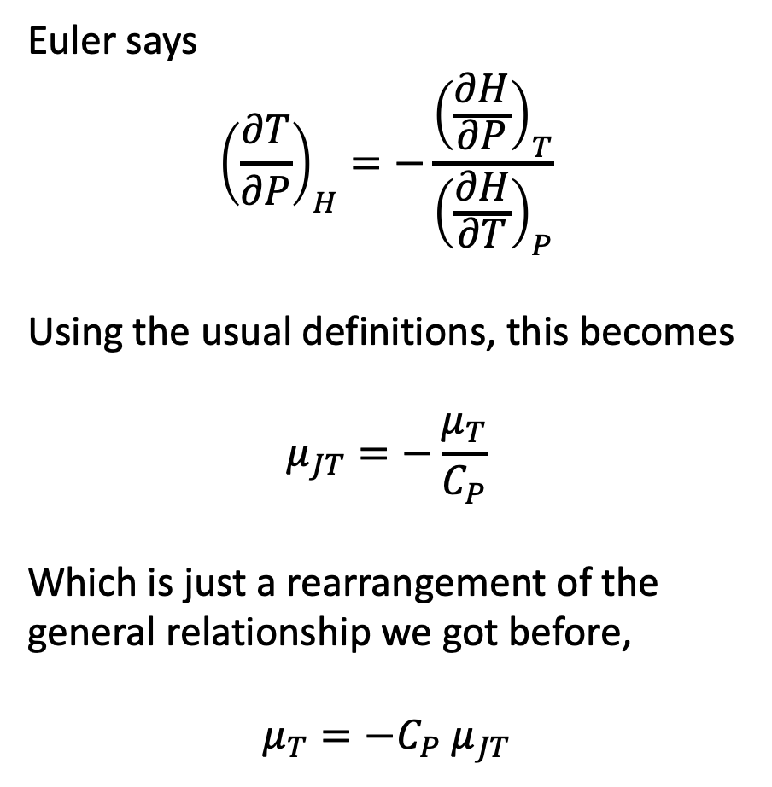
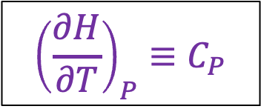
Euler’s Chain Relation (AKA the contour slope rule) applied to $H(T,P)$
Euler says
$${\left(\frac{∂T}{∂P}\right)}_{H}=−\frac{{\left(\frac{∂H}{∂P}\right)}_{T}}{{\left(\frac{∂H}{∂T}\right)}_{P}}$$
Using the usual definitions, this becomes
$$μ_{JT}=−\frac{μ_{T}}{C_{P}}$$
Which is just a rearrangement of the general relationship we got before,
$$μ_{T}=−C_{P}{ μ}_{JT}$$
$${{\left(\frac{∂H}{∂T}\right)}_{P}≡C}_{P}$$
$${{\left(\frac{∂H}{∂P}\right)}_{T}≡μ}_{T}$$
$${{\left(\frac{∂T}{∂P}\right)}_{H}≡μ}_{JT}$$

